Slide 1

ONLINE PRIVACY WITHOUT TEARS
Alison Macrina
alison@libraryfreedomproject.org
libraryfreedomproject.org

Slide 2
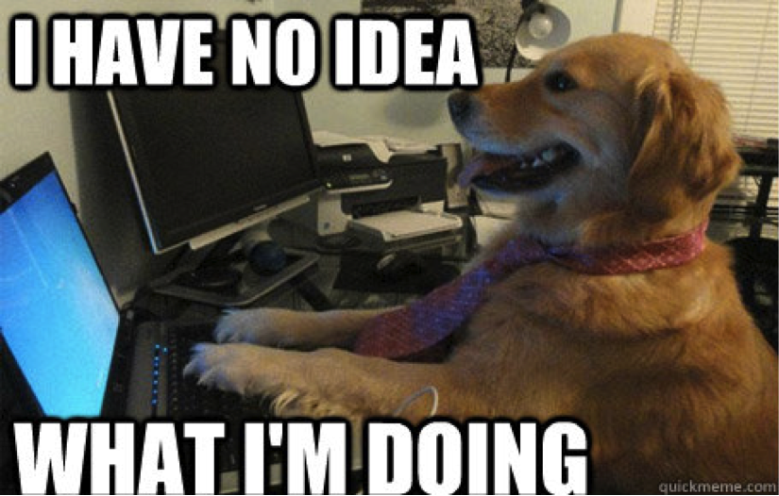
https://libraryfreedomproject.org/
resources/onlineprivacybasics/
The only link you need!

Slide 3
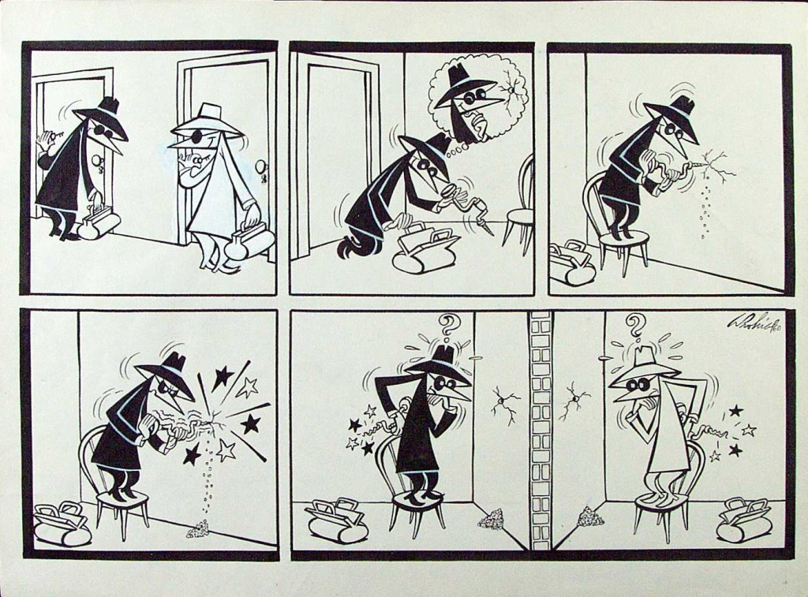
THREAT MODELING
-assets
-adversaries
-capabilities
-consequences

Slide 4
FREE SOFTWARE
the freedom to run, copy, distribute, study, change and improve the software (gnu.org)
-vs. proprietary software
-why does this matter for privacy?
-most of these tools are free software

Slide 5

SOFTWARE UPDATES

Slide 6
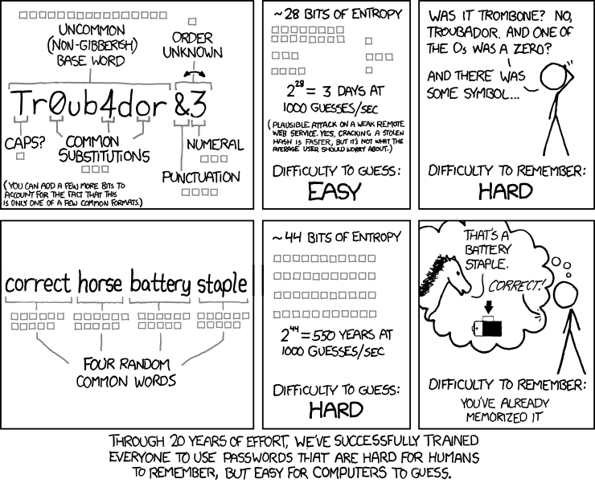
PASSWORDS

Slide 7
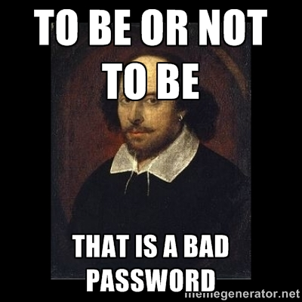
Your passwords are bad.
So are everyone else's.
-high entropy
COMPLEXITY! LENGTH!
NO PATTERNS!
-password managers
KeePassX
KeePass
1Password
-diceware list and die

Slide 8
FIREFOX + EXTENSIONS

Slide 9
-who owns your browser?
-what is a browser extension?
-Firefox and Tor
-Firefox privacy settings
-Firefox extensions menu

Slide 10

-behavioral analytics
-cookies
-analytics
-other unique identifiers
-Privacy Badger
-uBlock Origin
-DuckDuckGo search engine
This is a real image from an online marketing company.

Slide 11

-what is encryption?
1. confidentiality
2. authenticity
3. integrity
-http vs https
-HTTPS Everywhere

Slide 12
TOR BROWSER

Slide 13
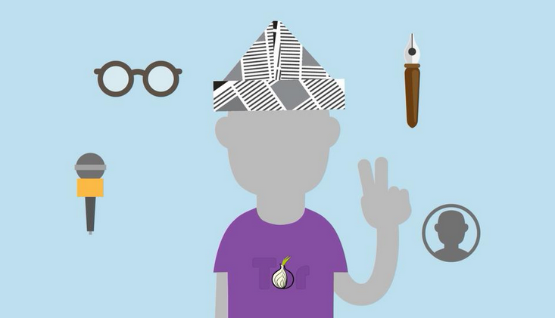
Tor is the most secure browser available.
-Tor vs. Firefox
-Tor extensions: HTTPS Everywhere and NoScript
-Tor best practices
-more with Tor (mobile, proxies)

Slide 14
LOCAL FILE MAINTENANCE

Slide 15

Cleans system and
protects privacy:
-trash
-logs
-recent places
-cache
-session data and more
CCLeaner – Windows and Mac OSX, not FOSS
*Windows users, do not ever use the registry cleaner!
Bleachbit – Windows and Linux, FOSS

Slide 16
DISK ENCRYPTION

Slide 17

-What does disk encryption do?
-Make sure to back up all files first!!!
-OS X: Filevault
-Windows: Bitlocker
-Linux: LUKS
-Alternative: Veracrypt

Slide 18
MOBILE DEVICES

Slide 19
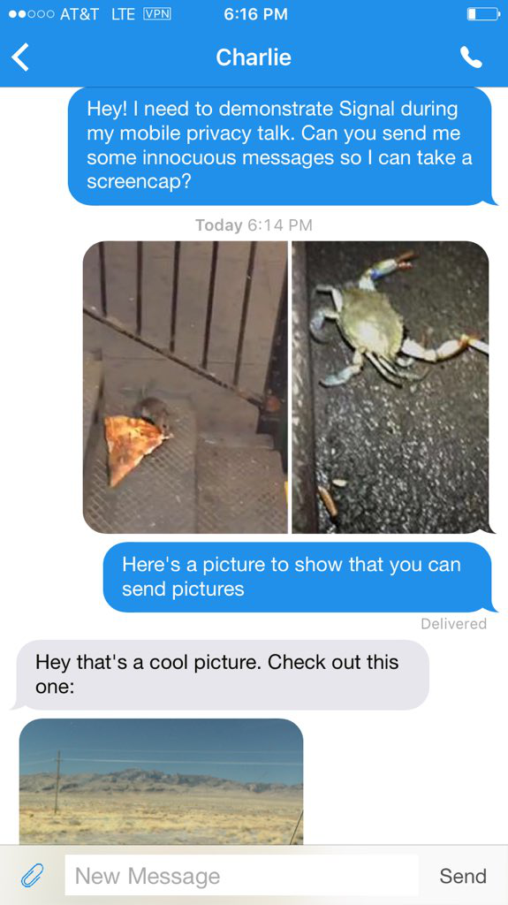
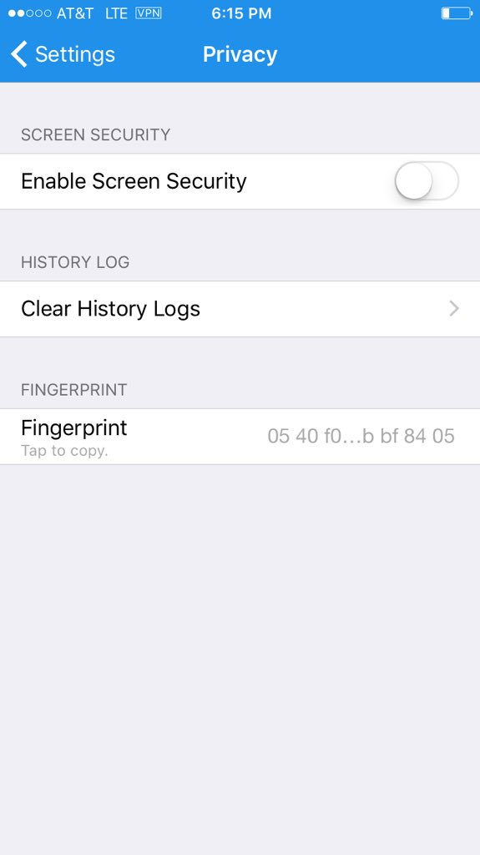
-LFP's mobile privacy toolkit
-Android vs iOS
-The Guardian Project (Android)
-Encrypted texts and calls with Signal (iOS and Android)

Slide 20
VIRUSES AND MALWARE

Slide 21
DON'T GET SCAMMED! BE SAFE!
-phishing, script kiddies, malicious links, malicious attachments, and other scams
-differences between viruses and malware
-relationship to privacy
-good practices
antivirus: ClamAV
antimalware: MalwareBytes (Windows only, free vs pro)

Slide 22
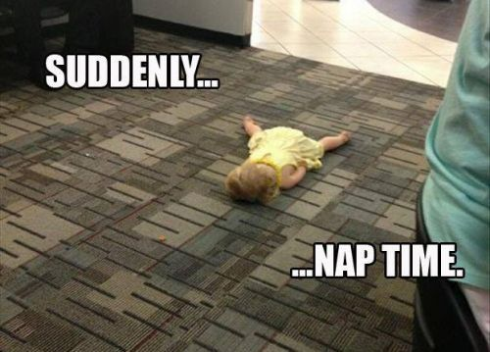
we're almost finished!

Slide 23

time for some difficult stuff!

Slide 24
EMAIL

Slide 25

    who can read your email?
    -your email service provider
    -operators of intermediate network connections
    -your intended recipient's email service provider
    -anyone who accesses those servers

Slide 26

      PGP encryption
          - email self-defense from FSF
      email providers
            - pobox.com
            -alumni email
            - a server you trust

Slide 27
VPN

Slide 28
-what is a VPN?
-what to look for in a VPN
-some options
-Bitmask (Android and Linux)
-Private Internet Access (iOS, OS X, Windows)

Slide 29
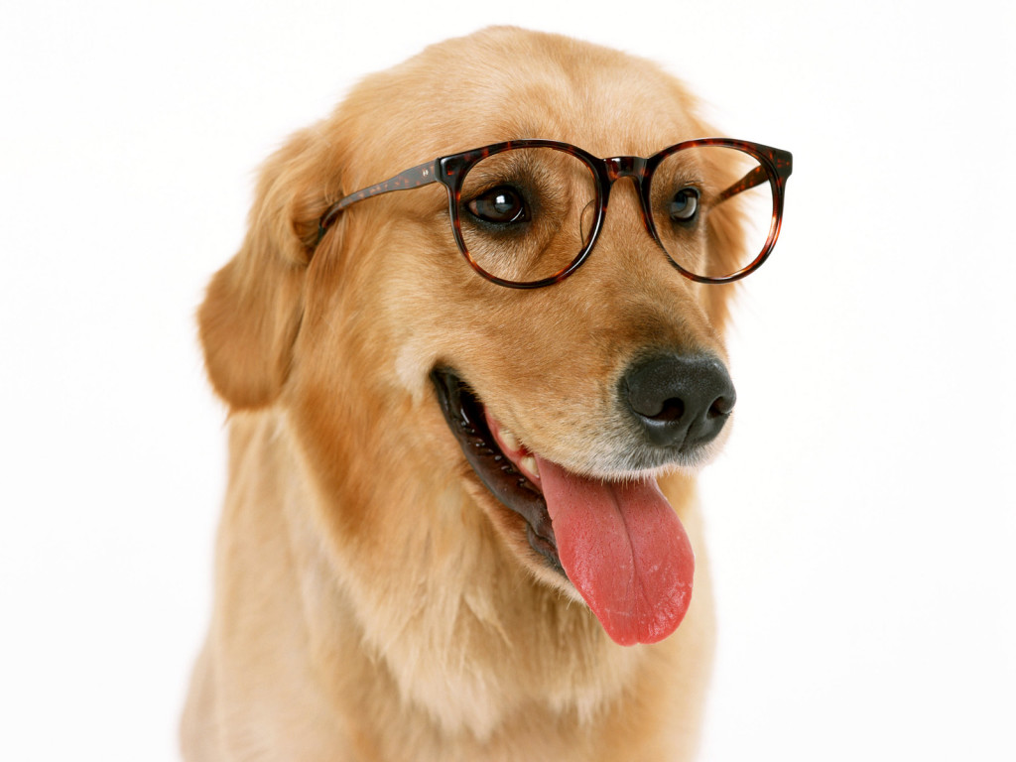
EXTRA CREDIT
-PRISM Break
-Surveillance Self- Defense (EFF)
-Schneier's blog
-Cryptoparties
-LFP resources

Slide 30


alison@libraryfreedomproject.org
@flexlibris
@libraryfreedom
libraryfreedomproject.org
Attribution-ShareAlike 4.0 International
www.creativecommons.org

